Slide 1

DATABASE NORMALIZATION
Docente: Dott. Daniele Gobbo Modulo 3

Slide 2
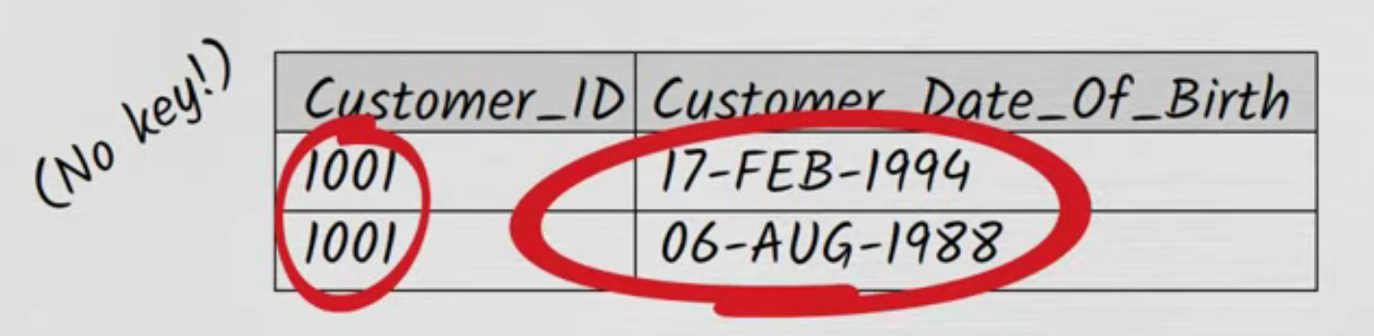
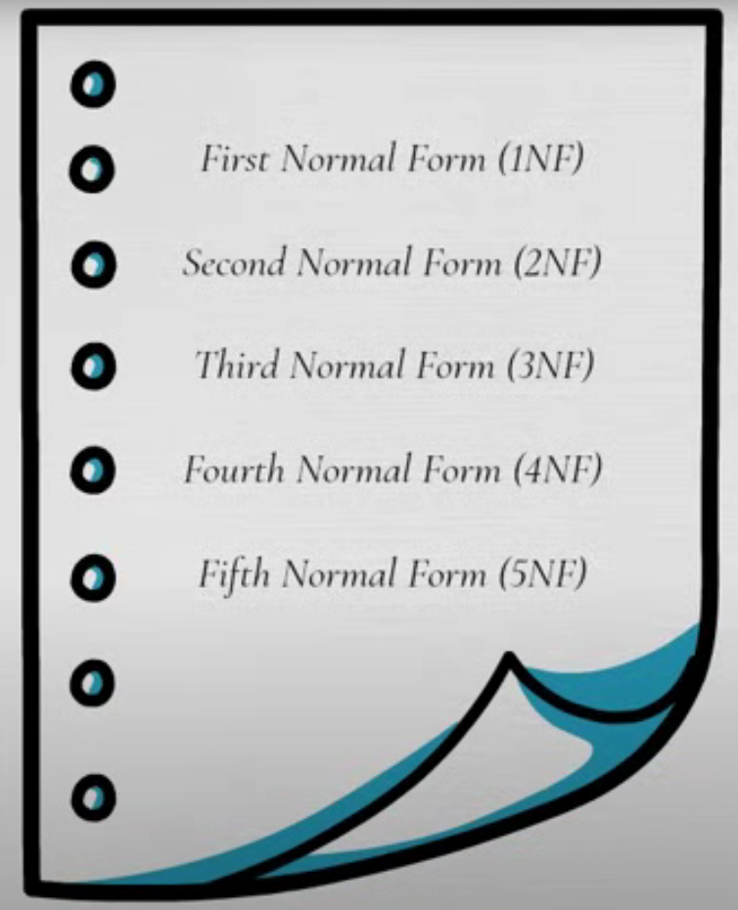
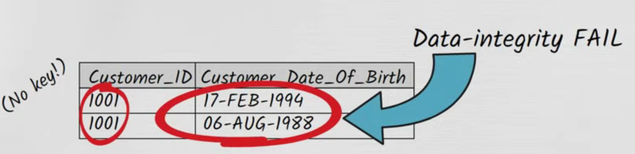
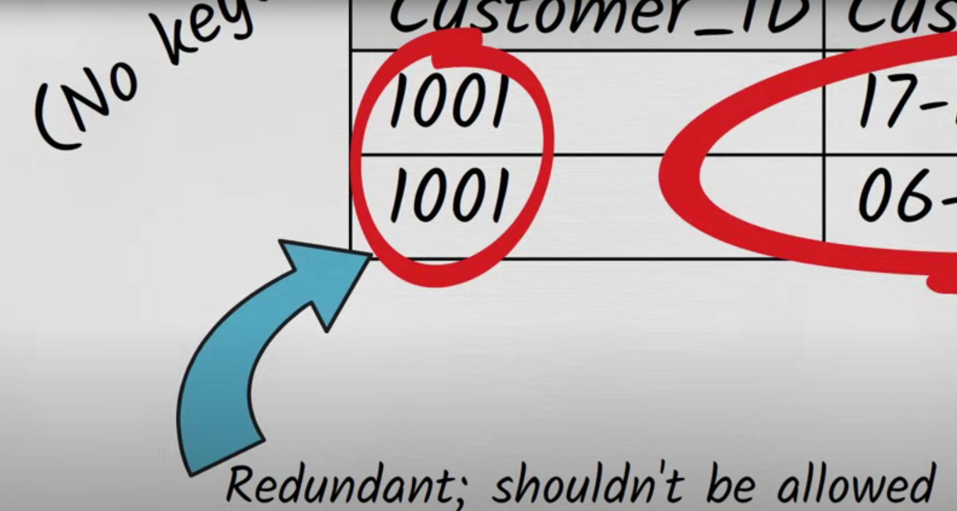

WHAT IS DATABASE NORMALIZATION?
WHAT does normalization mean?
When you normalize a database table, you structure it in such a way that can’t express rendundant information. For example in a normalized table, you wouldn’t be able to do that:

Slide 3
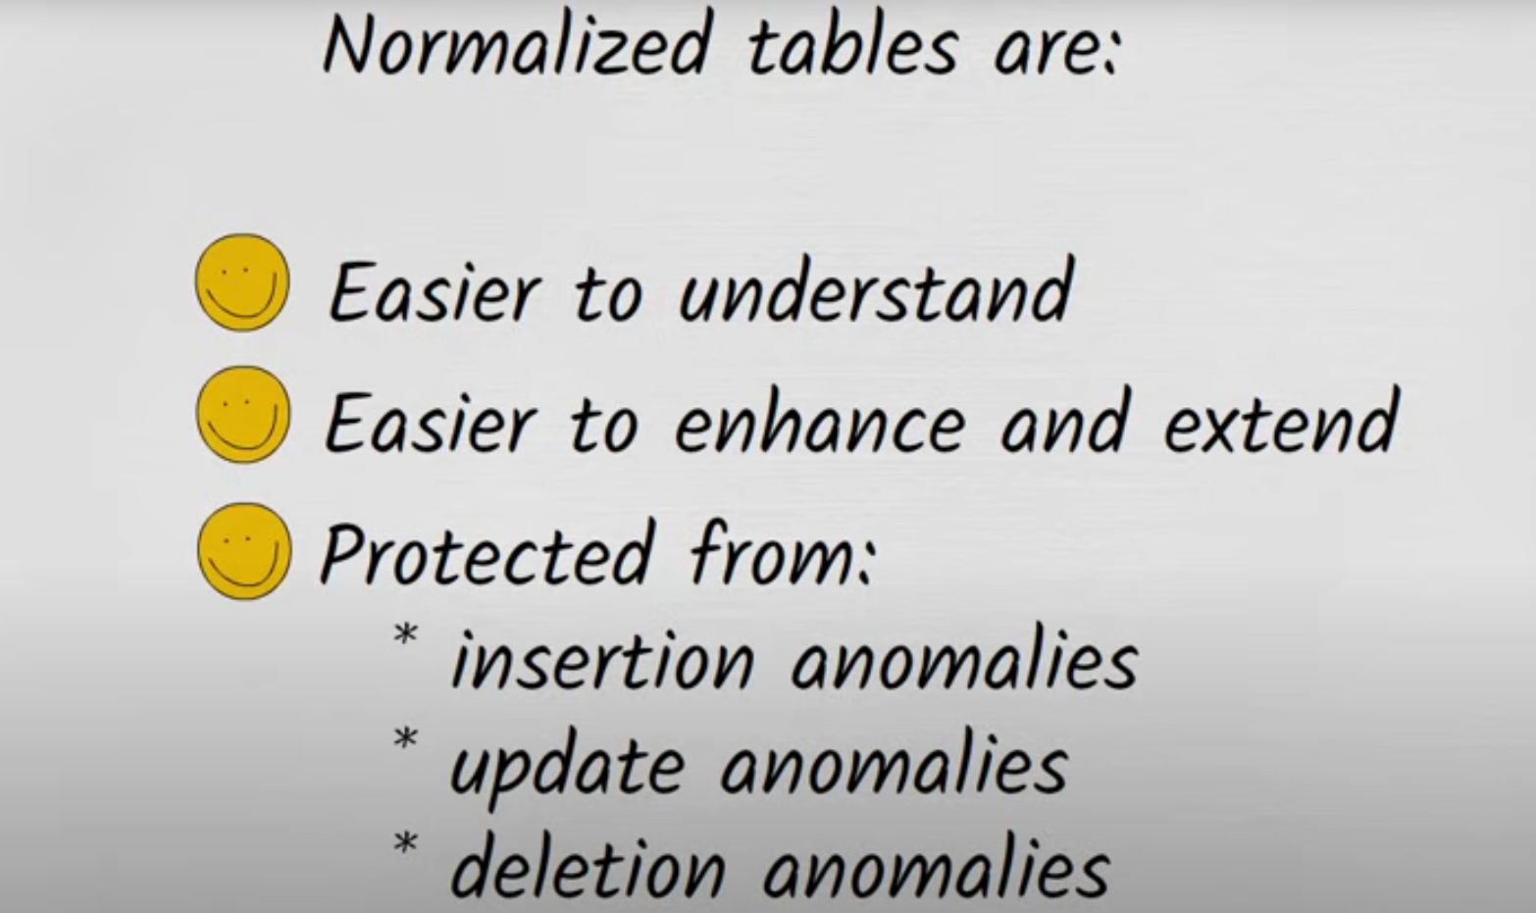
DATABASE NORMALIZATION

Slide 4
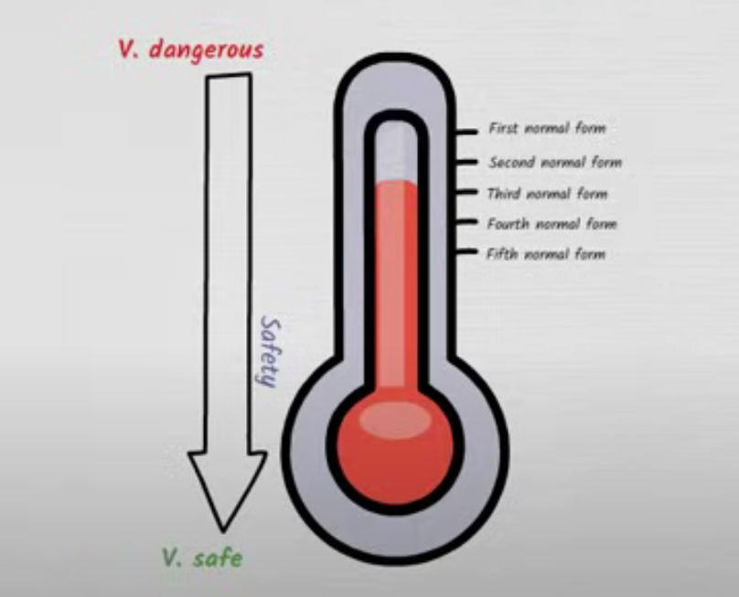
The normal forms
How can we determine it there’s a danger that redundant data could creep into the table?

Slide 5
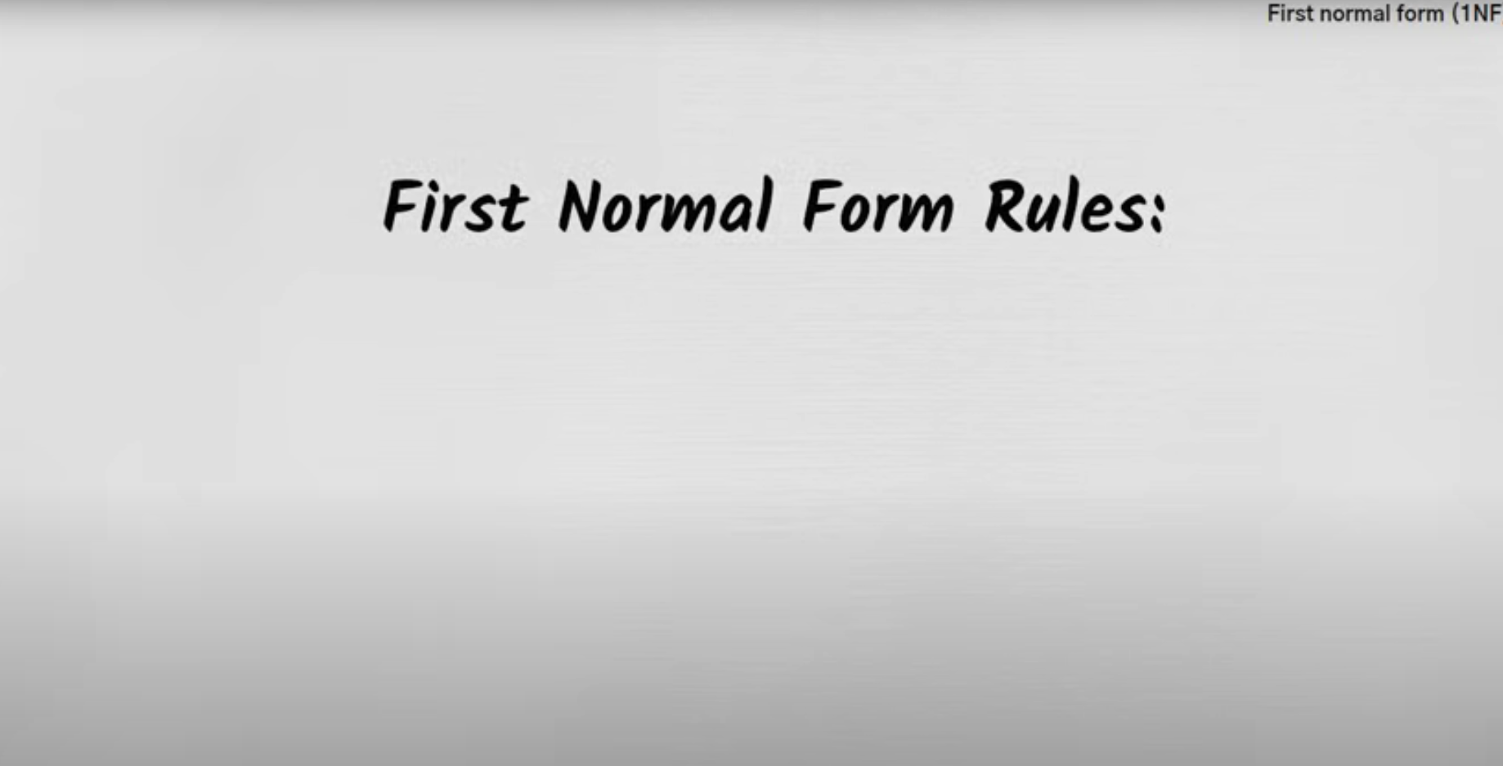
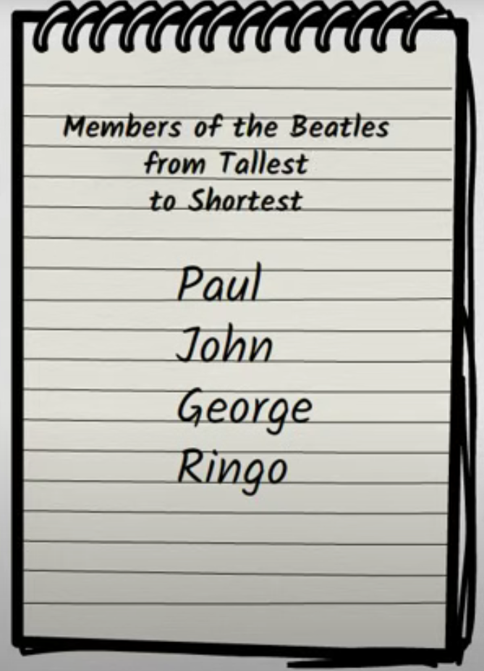
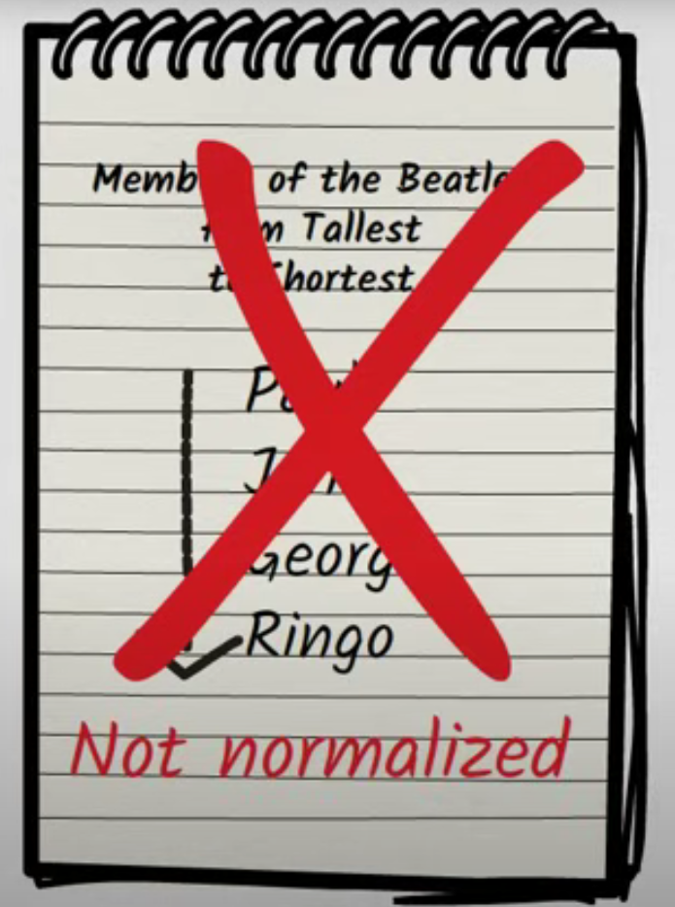
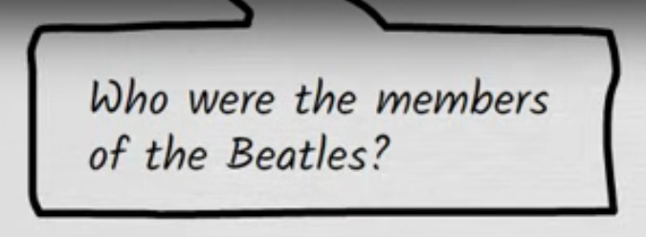
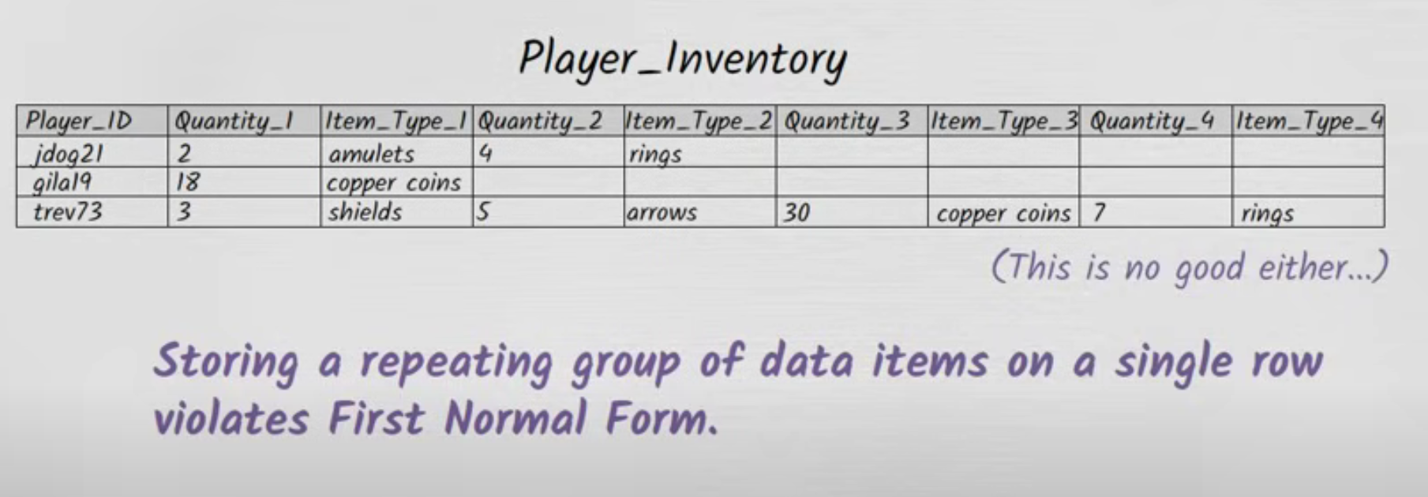
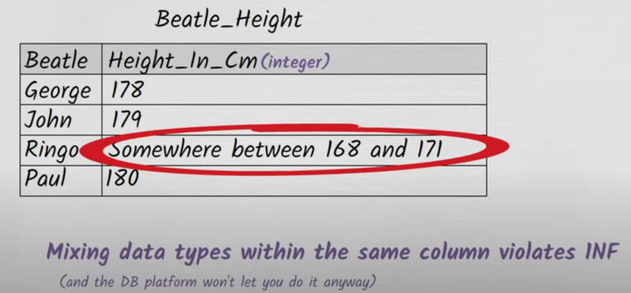
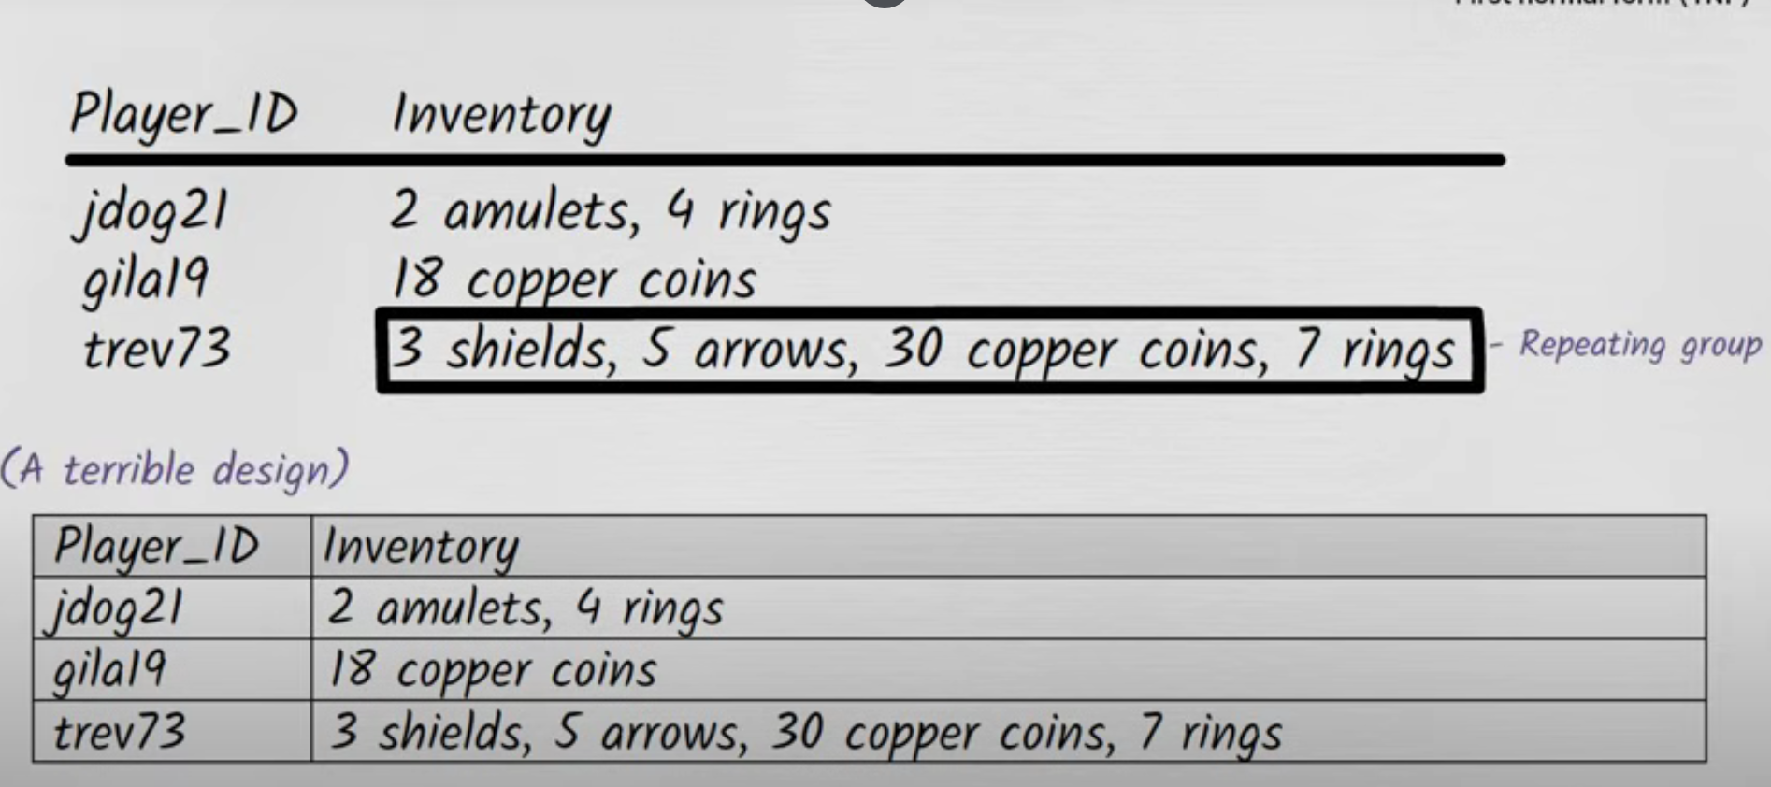
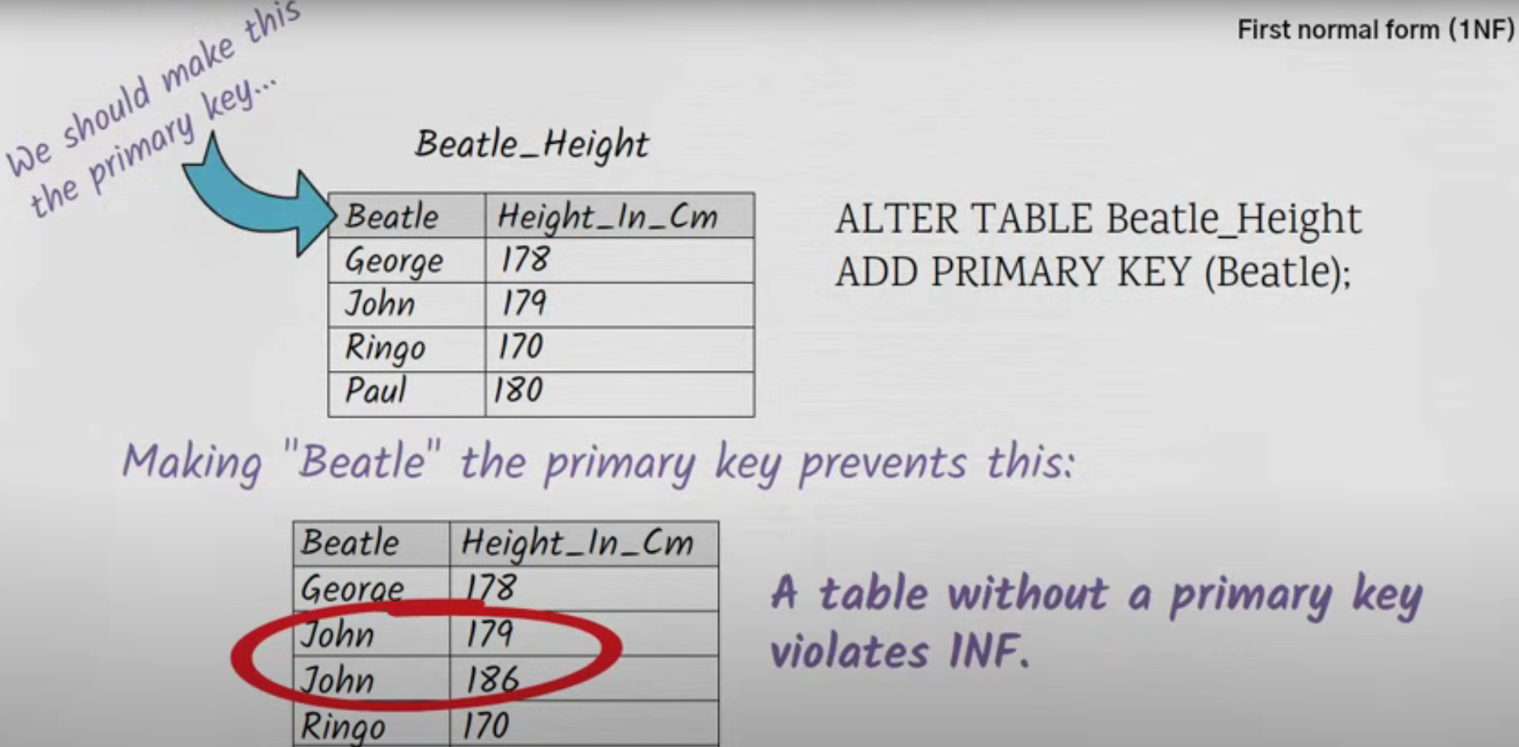

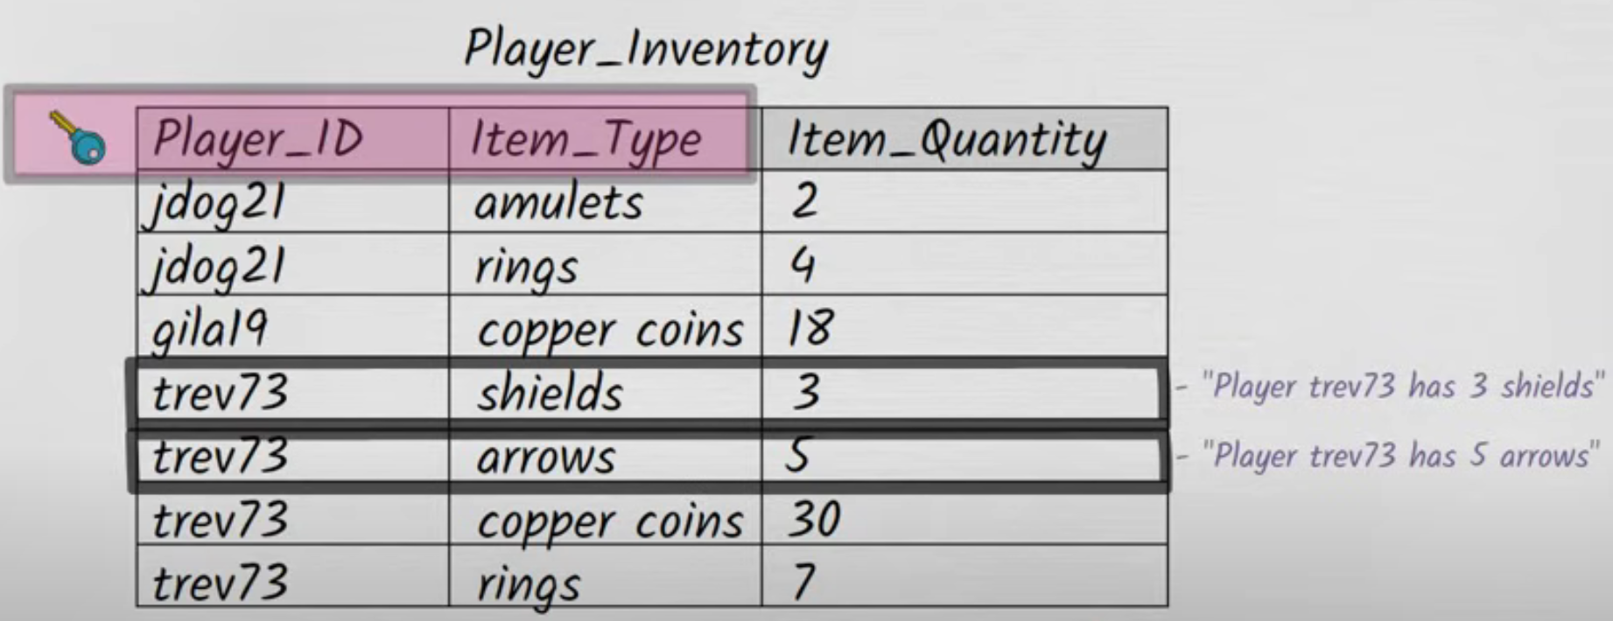
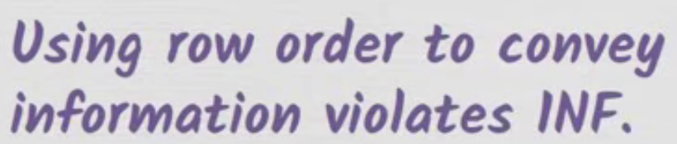
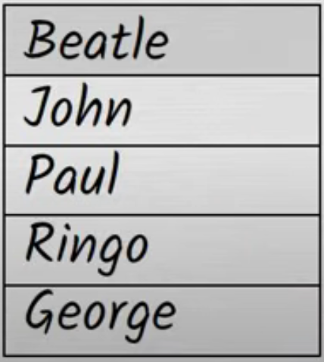
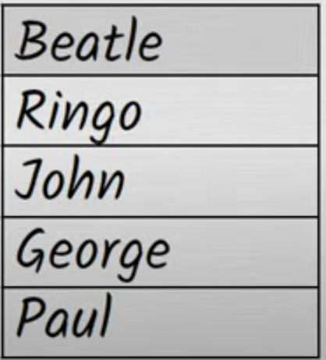
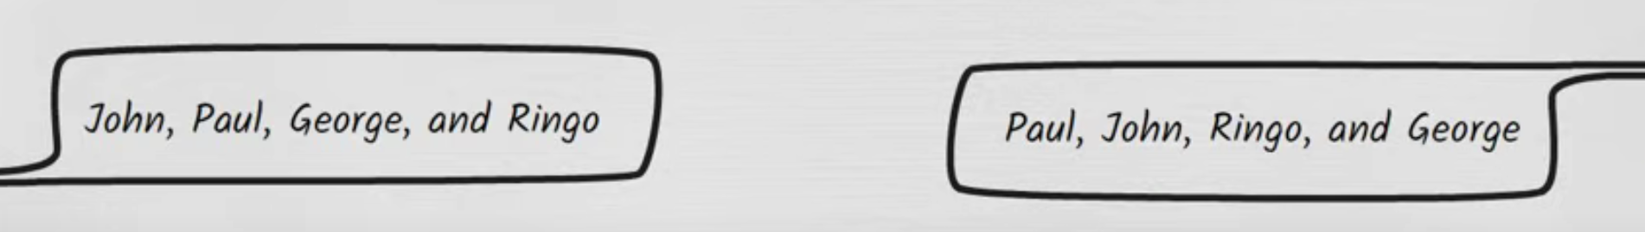
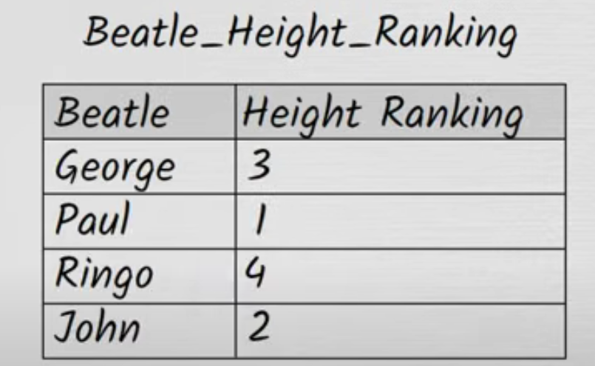
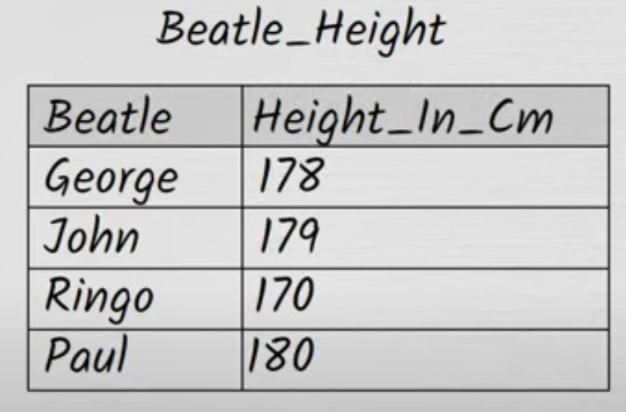
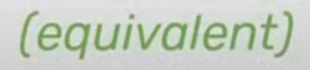

FIRST NORMAL FORM (1NF)
There is no «right» Order
The solution is very simple: BE EXPLICIT…
Are there ever situations where there’s a right order?

Slide 6
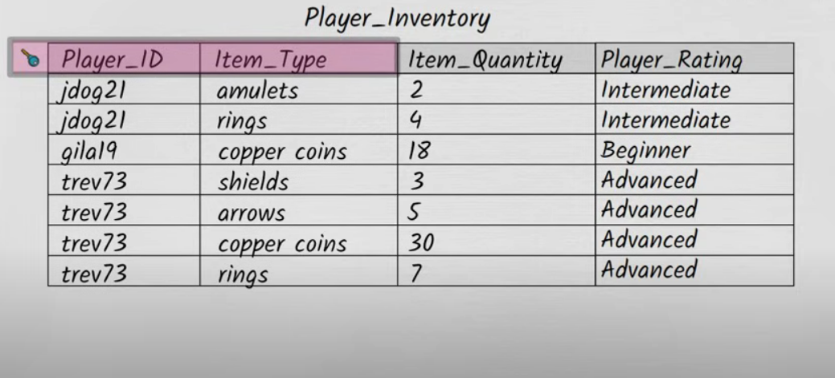
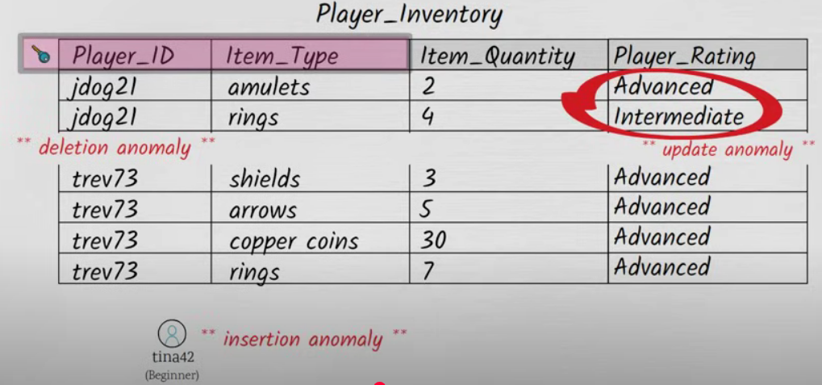
Second normal form (2NF)
The reason our design is vulnerable to these problems is that it isn’t in SECOND NORMAL FORM.
WHY NOT? WHAT IS SECONF NORMAL FORM?

Slide 7
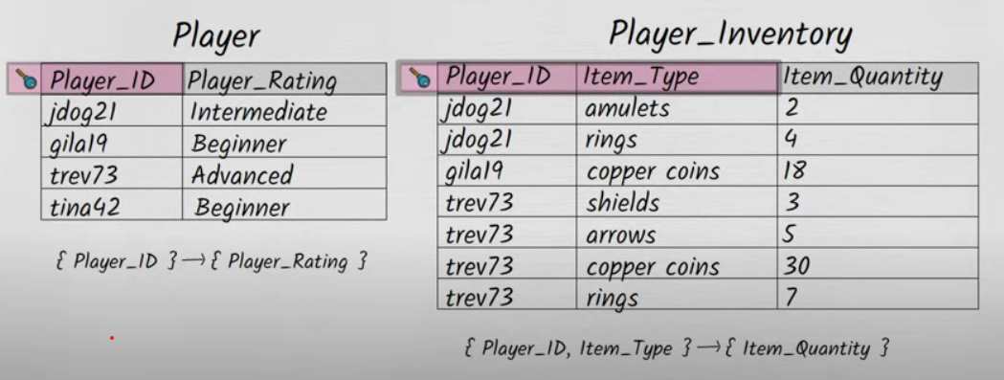
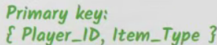
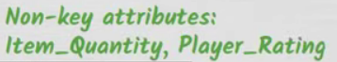
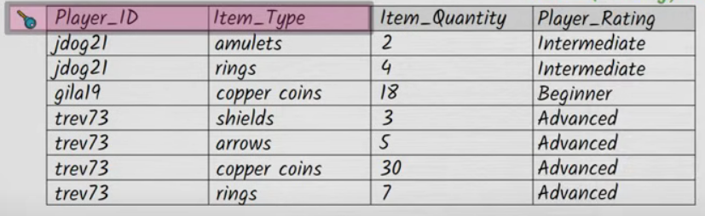
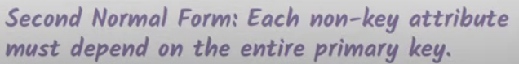
Second normal form (2NF)
SECOND NORMAL FORM is about how a tables non-key columns relate to the primary key
At what point did our design go wrong, and how can we fix it?
NOW OUR TABLES ARE IN SECOND NORMAL FORM
Does Item_Quantity depend on the entire primary key? YES

Slide 8
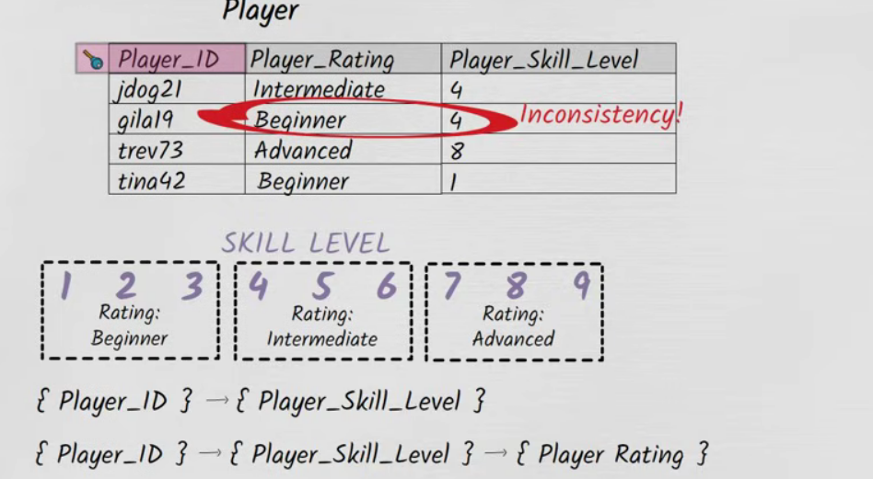
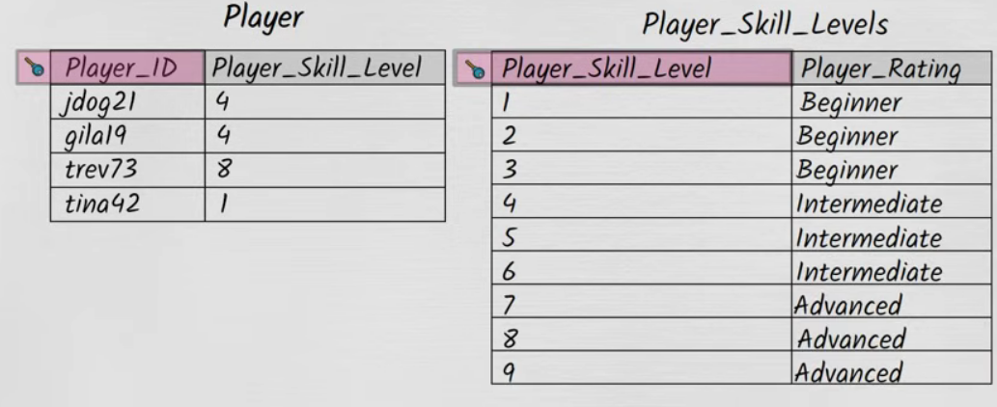
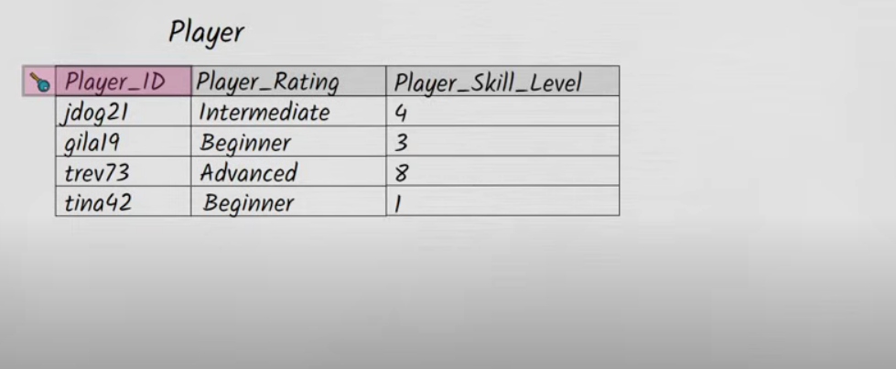
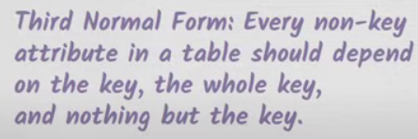
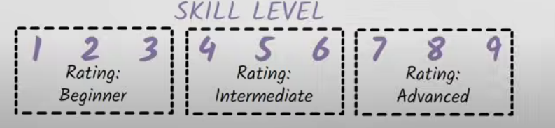
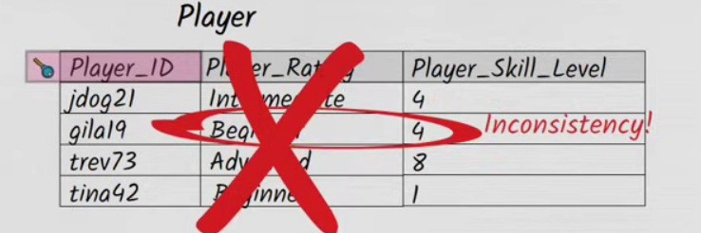
Third normal form (3NF)
NOW let’s move on to Third Nornal Form. Suppose we decide to enhance the player table
THIS TABLE IS NOT IN 3NF There’s a very simple way of repairing the design to get it into 3NF:
TRANSITIVE DEPENDENCY

Slide 9
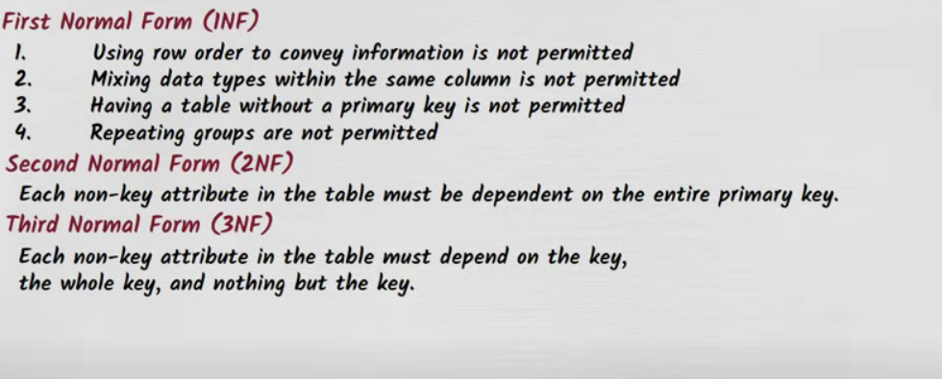
SUMMARY

Slide 10
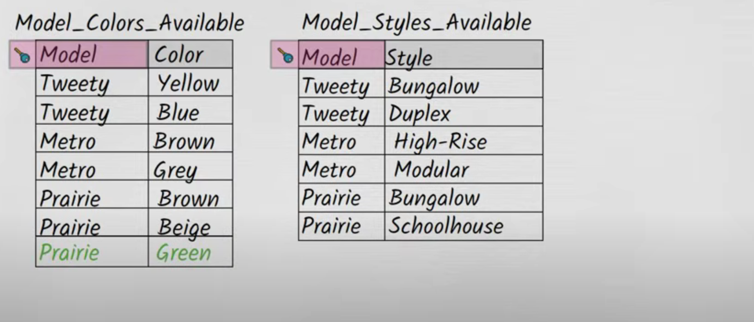
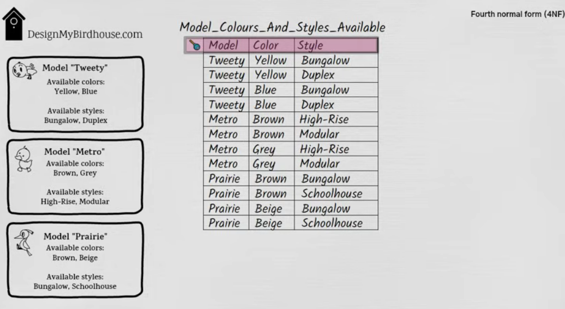
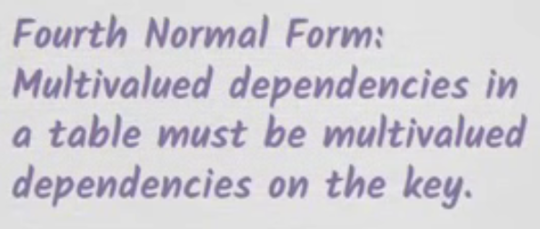

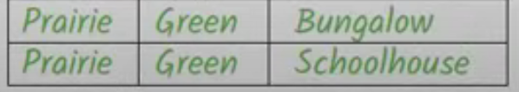


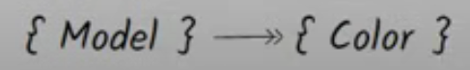
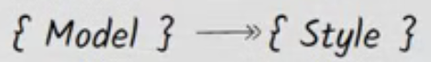
Fourth normal form (4NF)
Can we say that Color has a functional dependency on Model? NO because a specific Model isn’t associated with just one Color. We can say that each Model has a specific set of available Colors. This kind of dependency is called a MULTIVALUED DEPENDENCY
If by mistake we only add a row for green bungalow, and fail to add the row for green schoolhouse, than we have a data inconsistency
Available colors must be completely indipendent of available styles

Slide 11
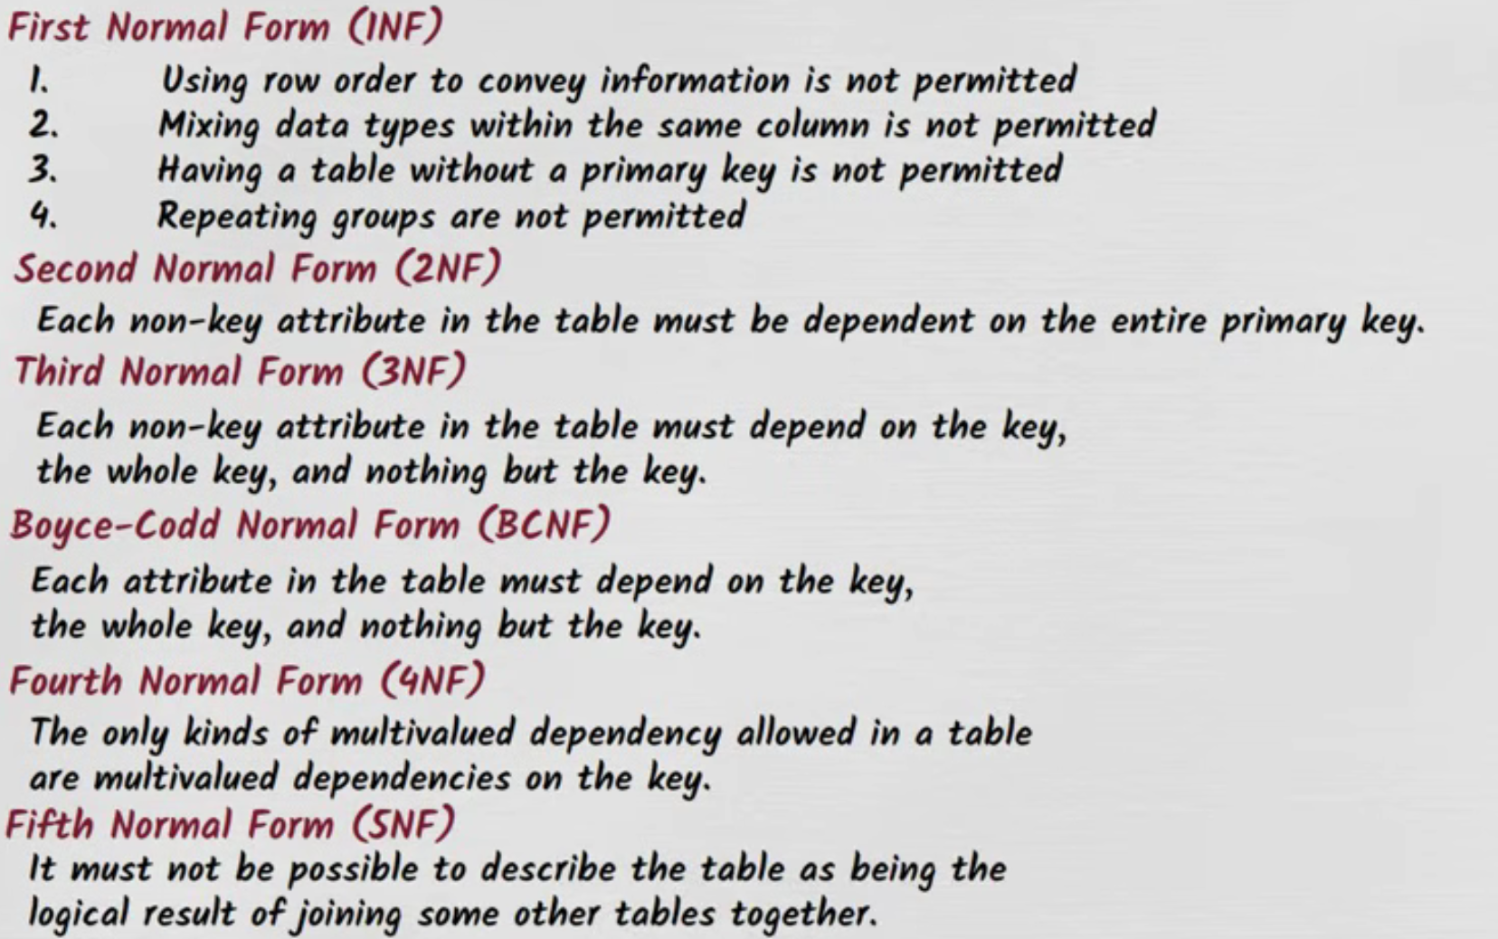
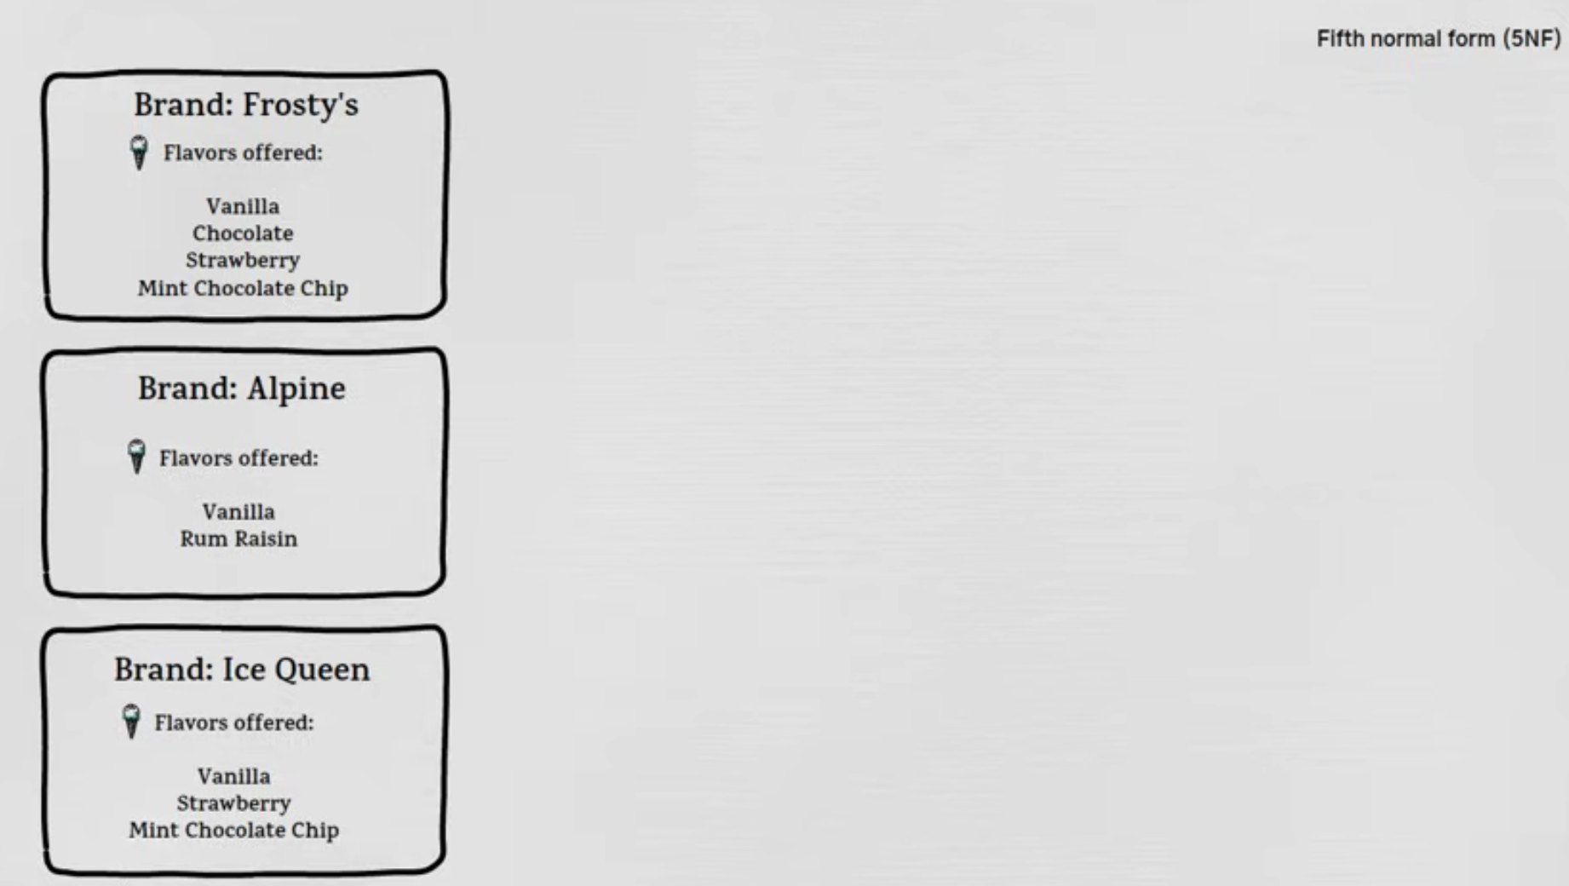
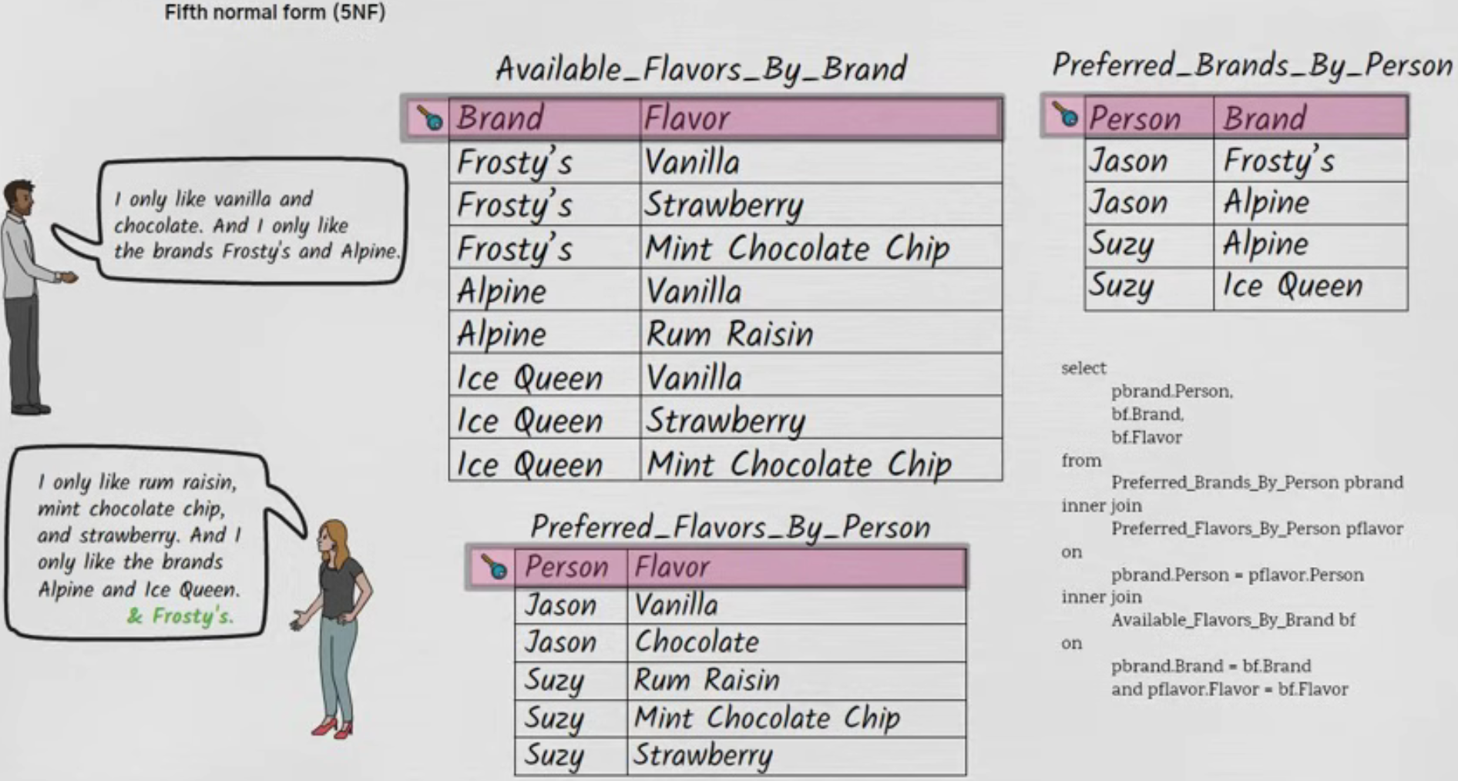
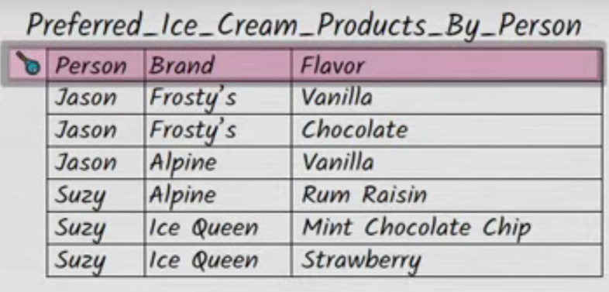
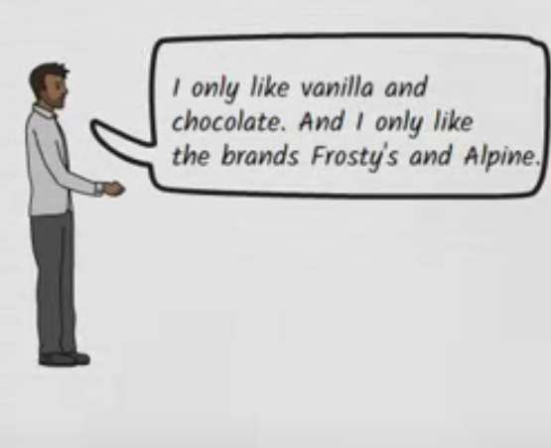
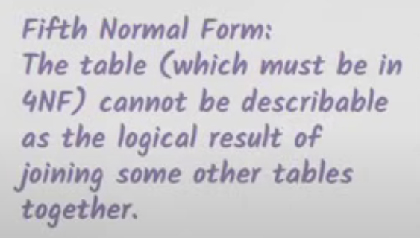
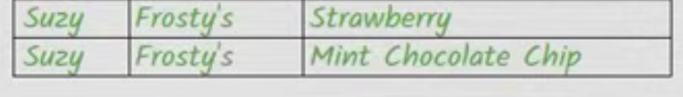
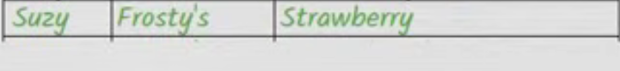


Fifth normal form (5NF)
BUT if we fail to add a row for SUZY – FROSTY- MINT CHOCOLATE CHIP….
This result is wrong and is also logically inconsistent

